Slide 1
Engineering Economy
Chapter 8: Price Changes and Exchange Rates

Slide 2
The objective of Chapter 8 is to present how inflation/deflation is dealt with in engineering economy studies.

Slide 3
Our assumption of constant prices for goods and services is generally not the case. General price inflation increases the average price of goods and services over time, while deflation results in a decrease in average prices (certainly a more rare circumstance).

Slide 4
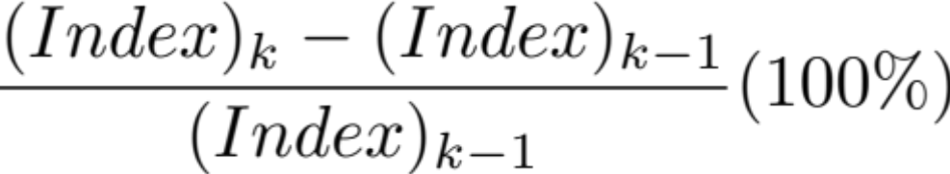
Changes in the consumer price index (CPI) and producer price index (PPI) are used as surrogate measures of inflation. The rate of change can be found, in either case, from the formula below.

Slide 5
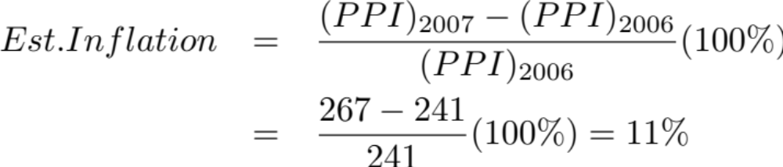
The oil refinery business has been in the news a lot. The general inflation rate for this industry for the 2007 calendar year can be found using the producer price index (from www.bls.gov).

Slide 6
There are a lot of terms to know!
Actual dollars (A$), also known as current, nominal, or inflated dollars, represent cash at the time it occurs.
Real dollars (R$), also known as constant dollars, are dollars expressed in terms of the same purchasing power relative to a particular time.
General price inflation (or deflation) rate (f), perhaps peculiar to particular business environment.

Slide 7
More terms to know.
Market (nominal) interest rate (i_{m}) is the money paid for the use of capital, adjusted for anticipated general price inflation.
Real interest rate (i_{r}) is the money paid for the use of capital, not adjusted for anticipated inflation (the inflation-free interest rate).
Base time period (b) is the reference or base time period used to define the constant purchasing power of real dollars.

Slide 8
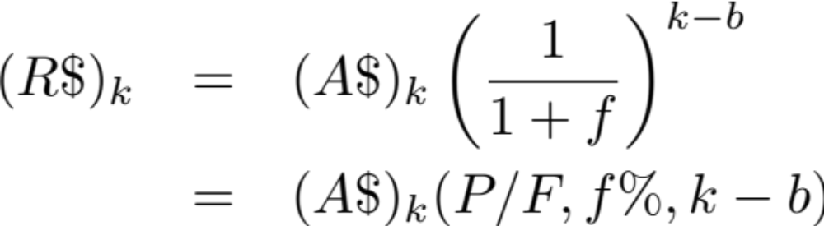
Actual dollars in year k can be converted into real dollars as of any base period by the relationship below (eq. 8-1).

Slide 9
Pause and solve
Acme is considering expanding their remote packaging facility. After-tax cash flows for their primary alternative are presented in the table below. If the general price inflation rate (f) is estimated to be 3.3% per year during the six-year analysis period, what is the real-dollar ATCF that is equivalent to the actual-dollar ATCF? The base time period is year zero (b = 0).
End of Year | ATCF (A$)
0 | -380,000
1 | 70,000
2 | 120,000
3 | 120,000
4 | 180,000
5 | 180,000
6 | 180,000

Slide 10
Solution
General price inflation rate (f): 3.3%
Find: the real-dollar ATCF that is equivalent to the actual-dollar ATCF? The base time period is year zero (b = 0).
End of Year | ATCF (A$) | (P/F,3.3%) | ATCF (R$)
0 | -380,000 | 1.0 | -380,000
1 | 70,000 | 0.9681 | 67,767
2 | 120,000 | 0.9371 | 112,452
3 | 120,000 | 0.9072 | 108,864
4 | 180,000 | 0.8782 | 158,076
5 | 180,000 | 0.8502 | 153,036
6 | 180,000 | 0.8230 | 148,140

Slide 11
It is important to use the correct dollar-type/interest-type combination. Otherwise, the results will be biased.
When cash flow estimates are made using actual dollars, A$, the correct rate to use is the market interest rate, i_{m} (which is adjusted for inflation).
When cash flow estimates are made using real dollars, R$, the correct rate to use is the real interest rate, i_{r}.

Slide 12

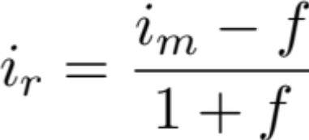
Relating the market interest rate and the real (inflation free) interest rate.
or

Slide 13
Pause and solve
Jill deposits $10,000 each year for eight years into an account earning 6% per year. During this time Jill expects general inflation to be 2% per year. At the end of eight years, what is the dollar value of Jill’s account in terms of today’s purchasing power (i.e., in real dollars)?

Slide 14
Solution
$10,000 each year for eight years, earning 6% per year. Inflation at 2% per year. At the end of eight years, find the dollar value in terms of today’s purchasing power (real dollars)?

Slide 15
Caution: Fixed and responsive annuities!
It is critical when performing engineering economic analyses that future cash flows be consistent, and perhaps converted, into either real or actual (constant) dollars, as appropriate, before performing the analysis.

Slide 16
Understanding differential price changes
Price changes for specific goods or services do not necessarily follow general price inflation (or deflation).
Let e_{j} be the % price change of good j, and e'_{j} be the % price change relative to the general inflation rate, f. Then
e_{j} = e'_{j} + f + e'_{j}(f) (eq. 8-7)

Slide 17
Foreign exchange rates can alter purchasing power, and should be considered in analyses of multiple world economies with varying economic circumstances. As exchange rates vary, the value of goods in a particular currency will fluctuate. The rate is analogous to changes in the general inflation rate.

Slide 18
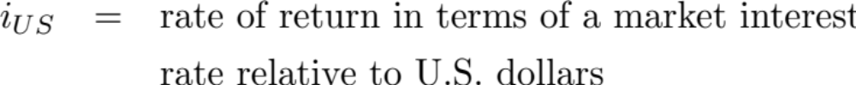
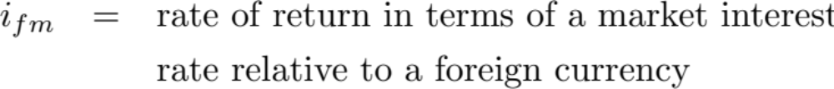
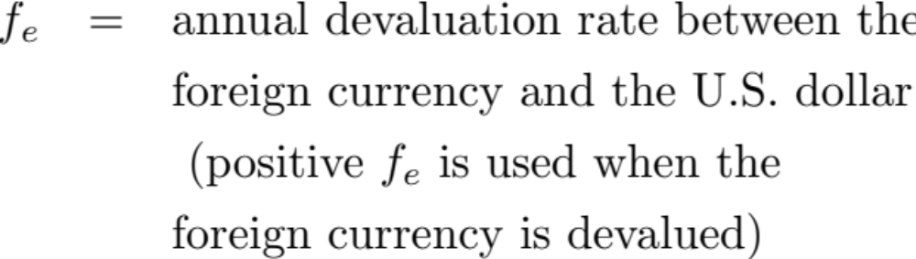
Let

Slide 19
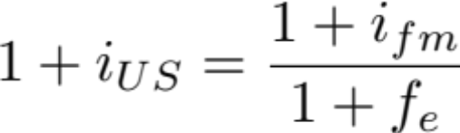
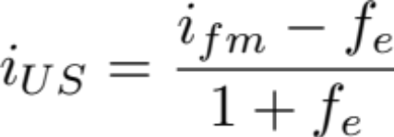
The relationship among these variables is
or
and

Slide 20
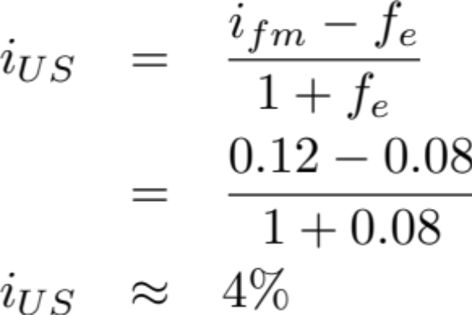
The currency of the country of Albatross, the grickle, is devalued against the U.S. dollar by 8% per year. The rate of return on an investment relative to the grickle in Albatross is 12%. What is the equivalent return relative to the dollar?

